Slide 1

Agile Software Development (TCS 855)
Extreme programming (XP)
Prof.(Dr.) Santosh Kumar
Department of Computer Science and Engineering
Graphic Era Deemed to be University, Dehradun

Slide 2
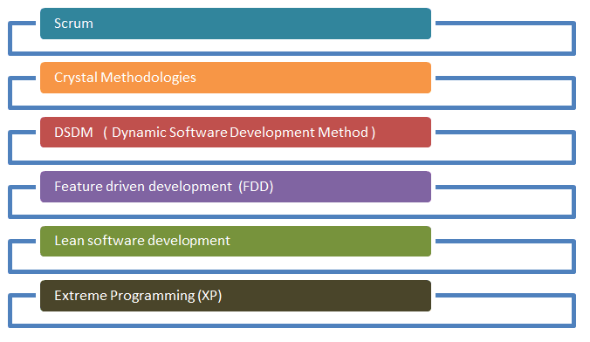
Agile Process Model
Figure: Agile Process Model

Slide 3
Extreme programming (XP)
Extreme programming (XP) is one of the most important software development framework of Agile models.
It is used to improve software quality and responsive to customer requirements.
The extreme programming model recommends taking the best practices that have worked well in the past in program development projects to extreme levels.

Slide 4
Good practices needs to practiced extreme programming:
Some of the good practices that have been recognized in the extreme programming model and suggested to maximize their use are given below:
Code Review: Code review detects and corrects errors efficiently. It suggests pair programming as coding and reviewing of written code carried out by a pair of programmers who switch their works between them every hour.
Testing: Testing code helps to remove errors and improves its reliability. XP suggests test-driven development (TDD) to continually write and execute test cases. In the TDD approach test cases are written even before any code is written.
Incremental development: Incremental development is very good because customer feedback is gained and based on this development team come up with new increments every few days after each iteration.
Simplicity: Simplicity makes it easier to develop good quality code as well as to test and debug it.
Design: Good quality design is important to develop a good quality software. So, everybody should design daily.
Integration testing: It helps to identify bugs at the interfaces of different functionalities. Extreme programming suggests that the developers should achieve continuous integration by building and performing integration testing several times a day.

Slide 5
Basic principles of Extreme programming
XP is based on the frequent iteration through which the developers implement User Stories.
User stories are simple and informal statements of the customer about the functionalities needed.
A User story is a conventional description by the user about a feature of the required system.
It does not mention finer details such as the different scenarios that can occur. On the basis of User stories, the project team proposes Metaphors.
Metaphors are a common vision of how the system would work. The development team may decide to build a Spike for some feature.
A Spike is a very simple program that is constructed to explore the suitability of a solution being proposed. It can be considered similar to a prototype.

Slide 6
Basic activities in Software Development (Using XP)
Some of the basic activities that are followed during software development by using XP model are given below:
Coding: The concept of coding which is used in XP model is slightly different from traditional coding. The coding activity includes drawing diagrams (modeling) that will be transformed into code, scripting a web-based system and choosing among several alternative solutions.
Testing: XP model gives high importance on testing and considers it be the primary factor to develop a fault-free software.
Listening: The developers needs to carefully listen to the customers if they have to develop a good quality software. Sometimes programmers may not have the depth knowledge of the system to be developed. So, it is desirable for the programmers to understand properly the functionality of the system and they have to listen to the customers.
Designing: Without a proper design, a system implementation becomes too complex and very difficult to understand the solution, thus it makes maintenance expensive. A good design results elimination of complex dependencies within a system. So, effective use of suitable design is emphasized.
Feedback: One of the most important aspects of the XP model is to gain feedback to understand the exact customer needs. Frequent contact with the customer makes the development effective.
Simplicity: The main principle of the XP model is to develop a simple system that will work efficiently in present time, rather than trying to build something that would take time and it may never be used. It focuses on some specific features that are immediately needed, rather than engaging time and effort on speculations of future requirements.

Slide 7
Applications of Extreme Programming (XP)
Some of the projects that are suitable to develop using XP model are given below:
Small projects: XP model is very useful in small projects consisting of small teams as face to face meeting is easier to achieve.
Projects involving new technology or Research projects: This type of projects face changing of requirements rapidly and technical problems. So XP model is used to complete this type of projects.

